Slide 1
Mysis Pilot Update

Slide 2
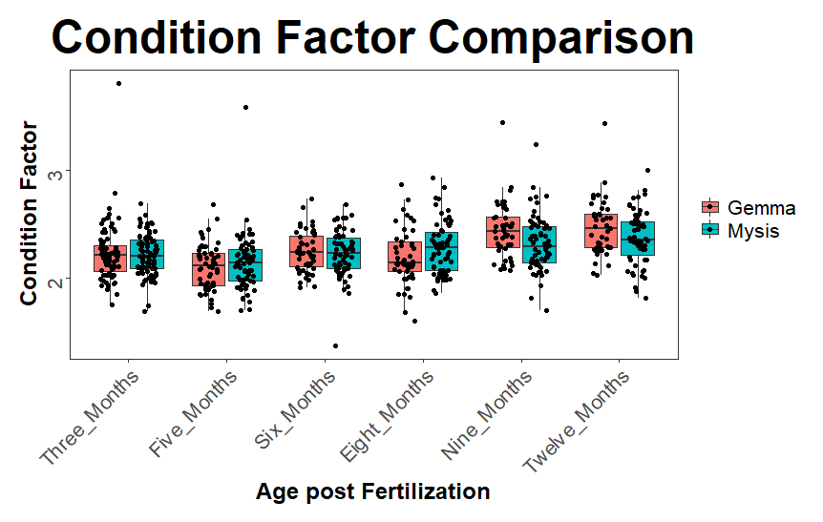

Slide 3
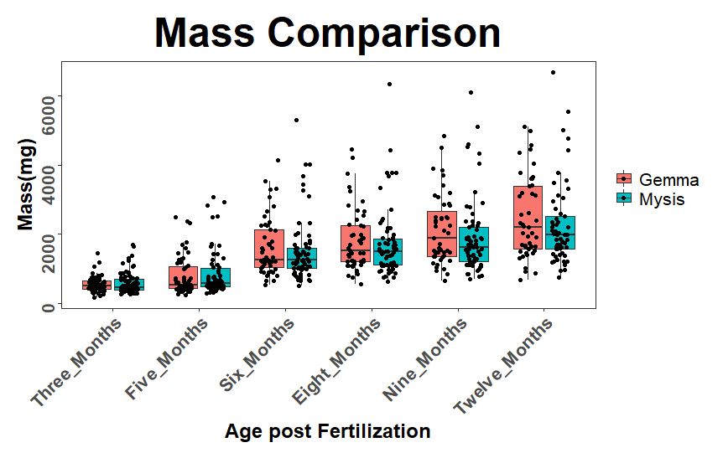

Slide 4
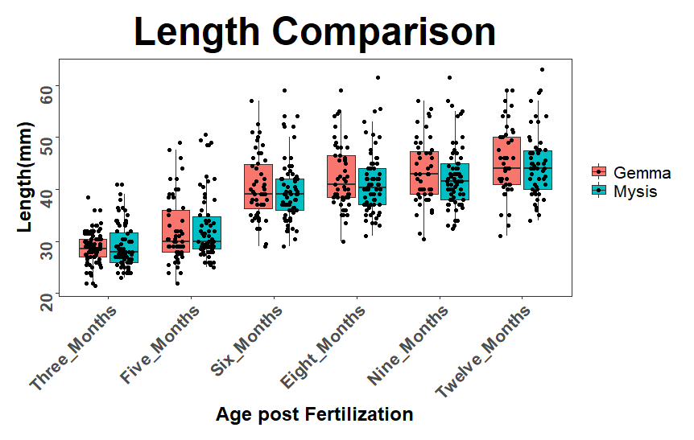

Slide 5
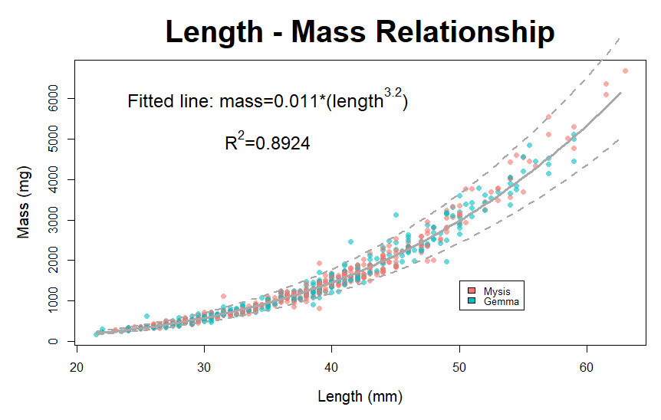

Slide 6
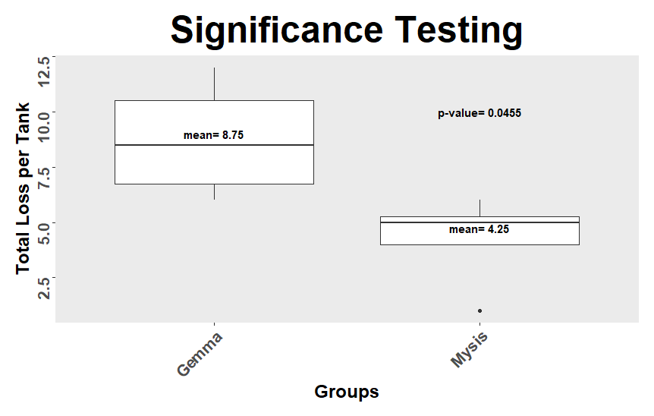

Slide 7
Gape Measurement Update
Age Category | Age (dpf) | Surface Average (um) | Pachon Average (um) | Current Feeding Size (um) | Proposed Feeding Size (um)
Larval | 4-7 | 533 | 649 | 75 | 300 (rotifers)
Fry | 8-19 | 706 | 824 | 150 | 500 (rotifers)
Fry+ | 20-49 | 1059 | 1266 | 300 | 500
Juvenile | 50-99 | 2125 | 1980 | 500 | 800
Sub-Adult | 100-179 | 1800 | 2990 | 500 | 800
Mixed Maturity | 180-364 | 2670 | 3400 | 800 | 1500
Adult | 365+ | 5845 | Not gathered | 800 | 1500

Slide 8
